Slide 1
Modern Machine Learning — Principal Component Analysis
Kenneth E. Barner
Department of Electrical and Computer Engineering
University of Delaware

Slide 2
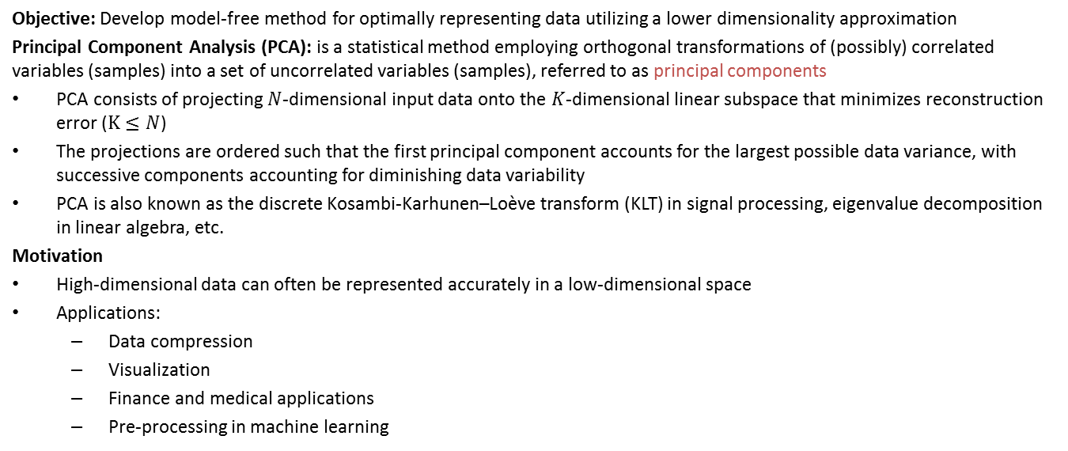
Principal Component Analysis
Objective: Develop model-free method for optimally representing data utilizing a lower dimensionality approximation
Principal Component Analysis (PCA): is a statistical method employing orthogonal transformations of (possibly) correlated variables (samples) into a set of uncorrelated variables (samples), referred to as principal components
PCA consists of projecting $N$-dimensional input data onto the $K$-dimensional linear subspace that minimizes reconstruction error ($K≤N$)
The projections are ordered such that the first principal component accounts for the largest possible data variance, with successive components accounting for diminishing data variability
PCA is also known as the discrete Kosambi-Karhunen–Loève transform (KLT) in signal processing, eigenvalue decomposition in linear algebra, etc.
Motivation
High-dimensional data can often be represented accurately in a low-dimensional space
Applications:
Data compression
Visualization
Finance and medical applications
Pre-processing in machine learning

Slide 3
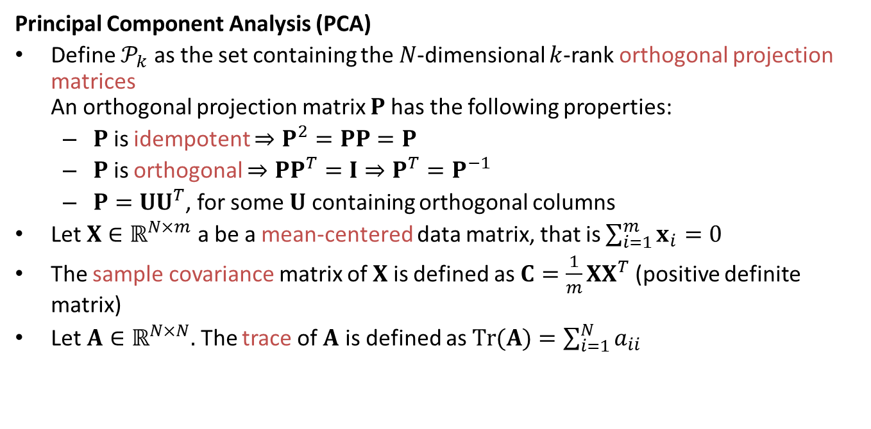
Principal Component Analysis
Principal Component Analysis (PCA)
Define $𝒫_{k}$ as the set containing the $N$-dimensional $k$-rank orthogonal projection matrices An orthogonal projection matrix $P$ has the following properties:
$P$ is idempotent $⇒P^{2}=PP=P$
$P$ is orthogonal $⇒PP^{T}=I⇒P^{T}=P^{−1}$
$P=UU^{T}$, for some $U$ containing orthogonal columns
Let $X∈ℝ^{N×m}$ a be a mean-centered data matrix, that is $\sum_{i=1}^{m}{x_{i}}=0$
The sample covariance matrix of $X$ is defined as $C=\frac{1}{m}XX^{T}$ (positive definite matrix)
Let $A∈ℝ^{N×N}.$ The trace of $A$ is defined as $Tr(A)=\sum_{i=1}^{N}{a_{ii}}$

Slide 4
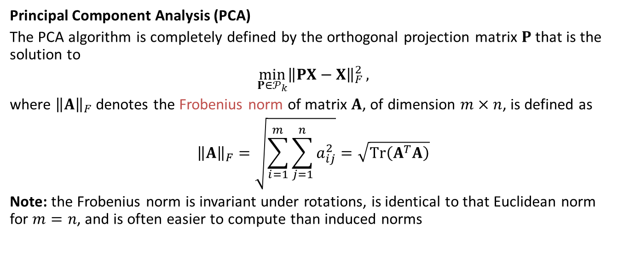
Principal Component Analysis
Principal Component Analysis (PCA)
The PCA algorithm is completely defined by the orthogonal projection matrix $P$ that is the solution to
$${\min_{P∈𝒫_{k}}\left\|PX−X\right\|}_{F}^{2},$$
where ${\left\|A\right\|}_{F}$ denotes the Frobenius norm of matrix $A$, of dimension $m×n$, is defined as
$${\left\|A\right\|}_{F}=\sqrt{\sum_{i=1}^{m}{\sum_{j=1}^{n}{a_{ij}^{2}}}}=\sqrt{Tr\left(A^{T}A\right)}$$
Note: the Frobenius norm is invariant under rotations, is identical to that Euclidean norm for $m=n$, and is often easier to compute than induced norms

Slide 5
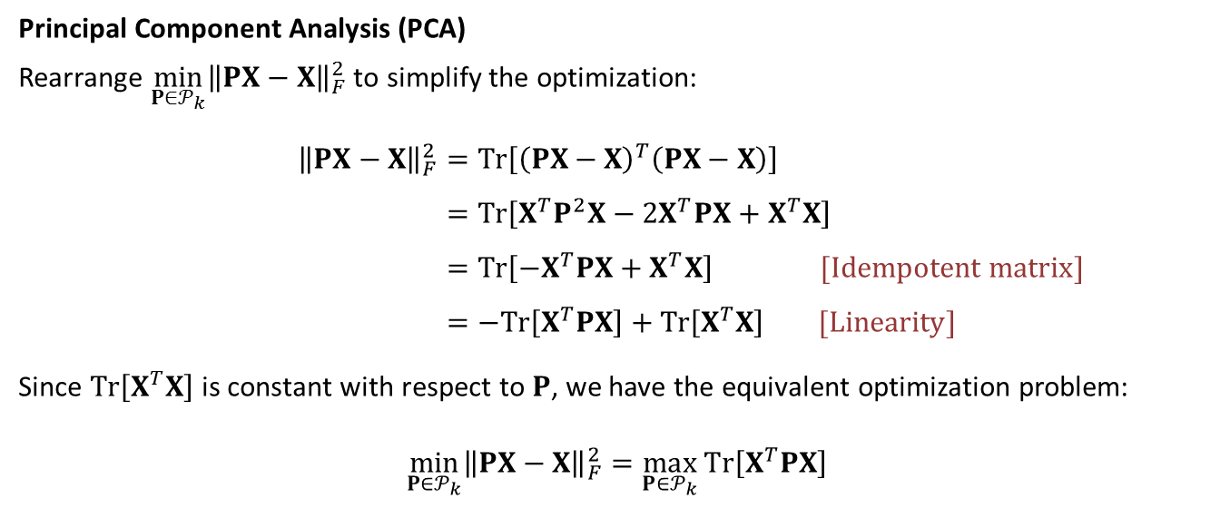
Principal Component Analysis
Principal Component Analysis (PCA)
Rearrange ${\min_{P∈𝒫_{k}}\left\|PX−X\right\|}_{F}^{2}$ to simplify the optimization:
$${\left\|PX−X\right\|}_{F}^{2}=Tr\left[{\left(PX−X\right)}^{T}\left(PX−X\right)\right] \\ =Tr\left[X^{T}P^{2}X−2X^{T}PX+X^{T}X\right] \\ =Tr\left[−X^{T}PX+X^{T}X\right] [Idempotent matrix] \\ =−Tr\left[X^{T}PX\right]+Tr\left[X^{T}X\right] [Linearity]$$
Since $Tr\left[X^{T}X\right]$is constant with respect to $P$, we have the equivalent optimization problem: $${\min_{P∈𝒫_{k}}\left\|PX−X\right\|}_{F}^{2}=\max_{P∈𝒫_{k}}{Tr\left[X^{T}PX\right]}$$

Slide 6
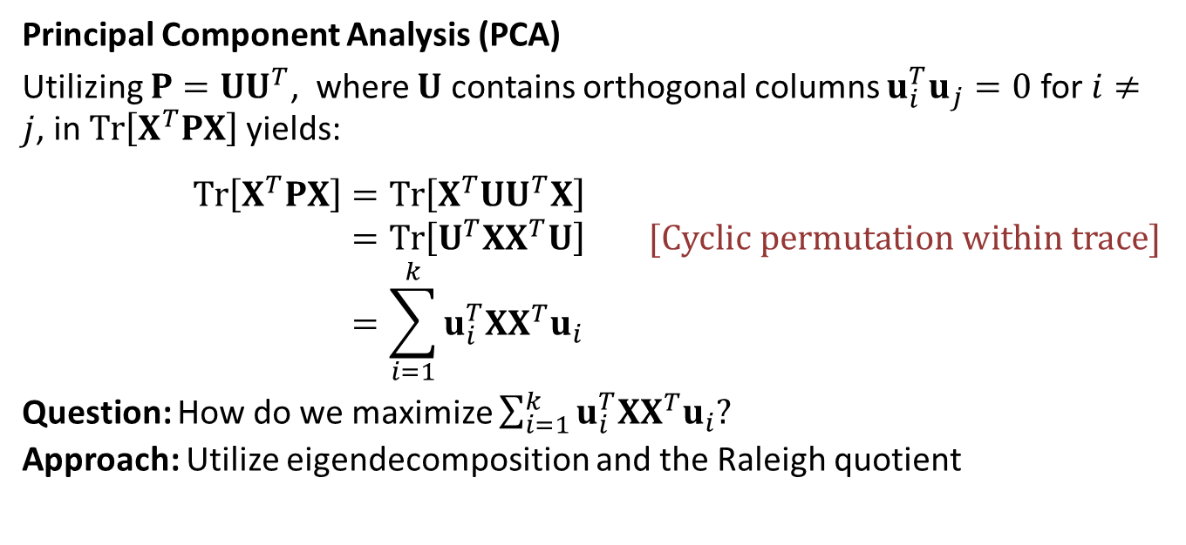
Principal Component Analysis
Principal Component Analysis (PCA)
Utilizing $P=UU^{T}$, where $U$ contains orthogonal columns ${u_{i}^{T}u}_{j}=0$ for $i≠j$, in $Tr\left[X^{T}PX\right]$ yields:
$$Tr\left[X^{T}PX\right]=Tr\left[X^{T}UU^{T}X\right] \\ =Tr\left[U^{T}XX^{T}U\right] [Cyclic permutation within trace] \\ =\sum_{i=1}^{k}{u_{i}^{T}XX^{T}u_{i}}$$
Question: How do we maximize $\sum_{i=1}^{k}{u_{i}^{T}XX^{T}u_{i}}$?
Approach: Utilize eigendecomposition and the Raleigh quotient

Slide 7
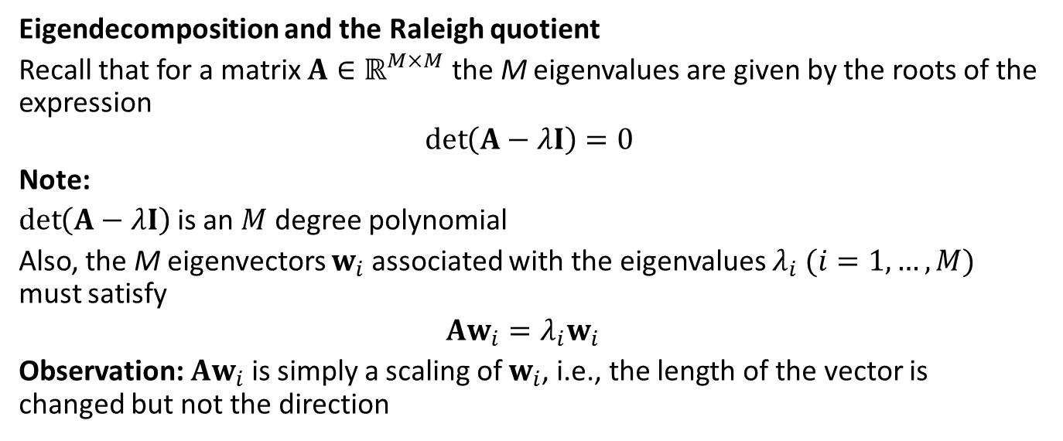
Principal Component Analysis
Eigendecomposition and the Raleigh quotient
Recall that for a matrix $A∈ℝ^{M×M}$ the M eigenvalues are given by the roots of the expression
$$\det\left(A−λI\right)=0$$
Note:
$\det\left(A−λI\right)$ is an $M$ degree polynomial
Also, the M eigenvectors $w_{i}$ associated with the eigenvalues $λ_{i}$ $(i=1,…,M)$ must satisfy
$$Aw_{i}=λ_{i}w_{i}$$
Observation: $Aw_{i}$ is simply a scaling of $w_{i}$, i.e., the length of the vector is changed but not the direction

Slide 8
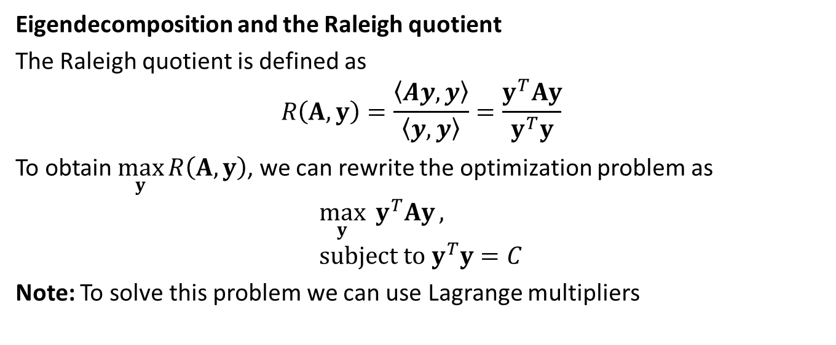
Principal Component Analysis
Eigendecomposition and the Raleigh quotient
The Raleigh quotient is defined as
$$R\left(A,y\right)=\frac{\left\langle Ay,y\right\rangle }{\left\langle y,y\right\rangle }=\frac{y^{T}Ay}{y^{T}y}$$
To obtain $\max_{y}{R\left(A,y\right)}$, we can rewrite the optimization problem as
$$\max_{y}{y^{T}Ay}, \\ subject to y^{T}y=C$$
Note: To solve this problem we can use Lagrange multipliers

Slide 9
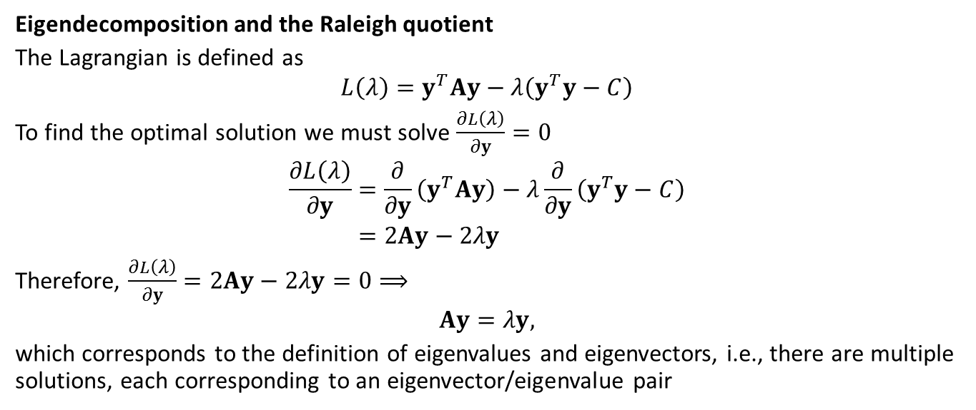
Principal Component Analysis
Eigendecomposition and the Raleigh quotient
The Lagrangian is defined as
$$L\left(λ\right)=y^{T}Ay−λ\left(y^{T}y−C\right)$$
To find the optimal solution we must solve $\frac{∂L\left(λ\right)}{∂y}=0$
$$\frac{∂L\left(λ\right)}{∂y}=\frac{∂}{∂y}\left(y^{T}Ay\right)−λ\frac{∂}{∂y}\left(y^{T}y−C\right) \\ =2Ay−2λy$$
Therefore, $\frac{∂L\left(λ\right)}{∂y}=2Ay−2λy=0⟹$
$$Ay=λy,$$
which corresponds to the definition of eigenvalues and eigenvectors, i.e., there are multiple solutions, each corresponding to an eigenvector/eigenvalue pair

Slide 10
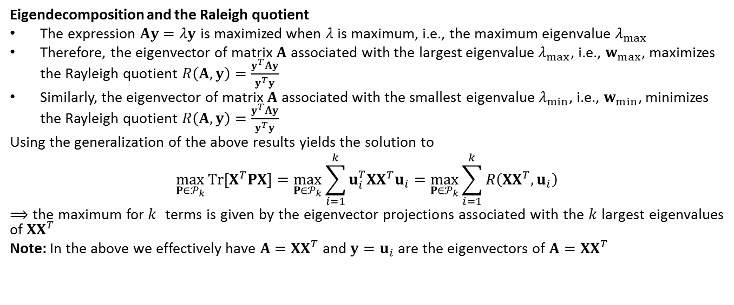
Principal Component Analysis
Eigendecomposition and the Raleigh quotient
The expression $Ay=λy$ is maximized when $λ$ is maximum, i.e., the maximum eigenvalue $λ_{max}$
Therefore, the eigenvector of matrix $A$ associated with the largest eigenvalue $λ_{max}$, i.e., $w_{max}$, maximizes the Rayleigh quotient $R\left(A,y\right)=\frac{y^{T}Ay}{y^{T}y}$
Similarly, the eigenvector of matrix $A$ associated with the smallest eigenvalue $λ_{min}$, i.e., $w_{min}$, minimizes the Rayleigh quotient $R\left(A,y\right)=\frac{y^{T}Ay}{y^{T}y}$
Using the generalization of the above results yields the solution to
$$\max_{P∈𝒫_{k}}{Tr\left[X^{T}PX\right]}=\max_{P∈𝒫_{k}}{\sum_{i=1}^{k}{u_{i}^{T}XX^{T}u_{i}}}=\max_{P∈𝒫_{k}}{\sum_{i=1}^{k}{R\left(XX^{T},u_{i}\right)}}$$
$⟹$ the maximum for $k$ terms is given by the eigenvector projections associated with the $k$ largest eigenvalues of $XX^{T}$
Note: In the above we effectively have $A=XX^{T}$ and ${y=u}_{i}$ are the eigenvectors of $A=XX^{T}$

Slide 11
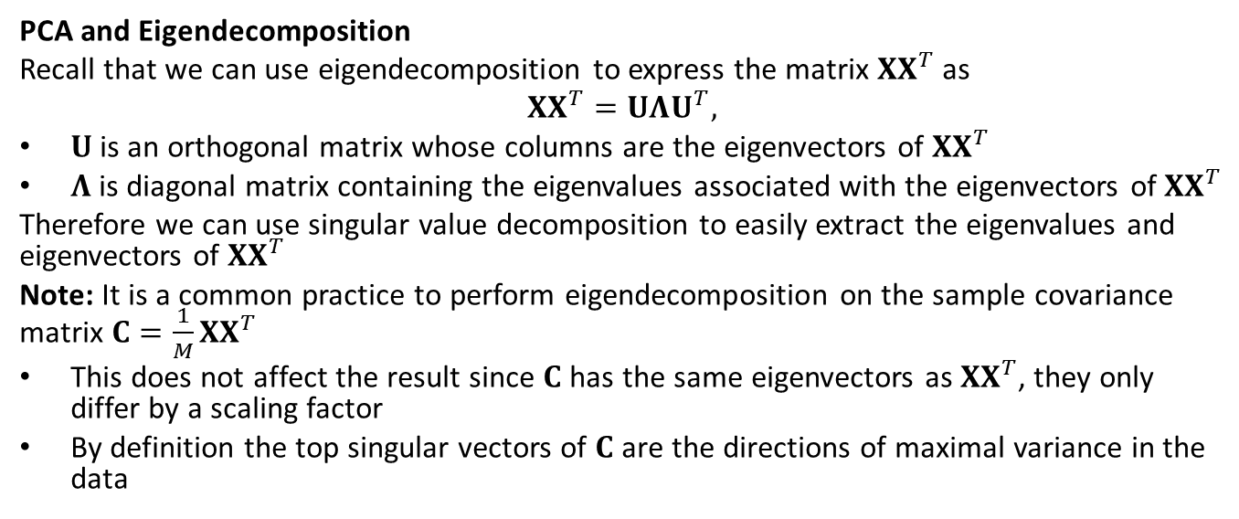
Principal Component Analysis
PCA and Eigendecomposition
Recall that we can use eigendecomposition to express the matrix $XX^{T}$ as
$$XX^{T}=UΛU^{T},$$
$U$ is an orthogonal matrix whose columns are the eigenvectors of $XX^{T}$
$Λ$ is diagonal matrix containing the eigenvalues associated with the eigenvectors of $XX^{T}$
Therefore we can use singular value decomposition to easily extract the eigenvalues and eigenvectors of $XX^{T}$
Note: It is a common practice to perform eigendecomposition on the sample covariance matrix $C=\frac{1}{M}XX^{T}$
This does not affect the result since $C$ has the same eigenvectors as $XX^{T}$, they only differ by a scaling factor
By definition the top singular vectors of $C$ are the directions of maximal variance in the data

Slide 12
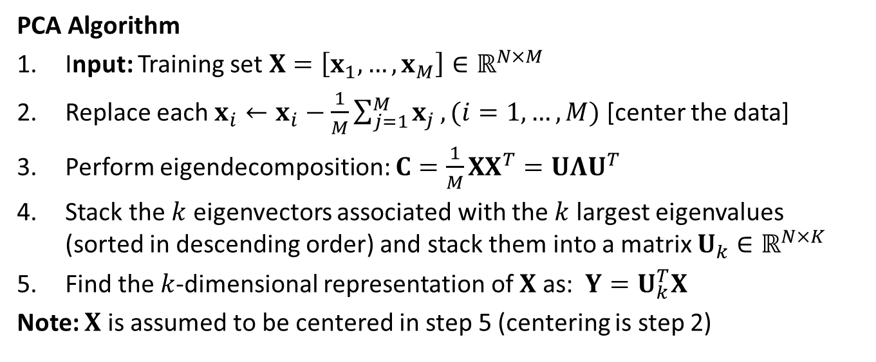
Principal Component Analysis
PCA Algorithm
Input: Training set $X=\left[x_{1},…,x_{M}\right]∈ℝ^{N×M}$
Replace each $x_{i}←x_{i}−\frac{1}{M}\sum_{j=1}^{M}{x_{j}}, (i=1,…,M)$ [center the data]
Perform eigendecomposition: $C=\frac{1}{M}XX^{T}=UΛU^{T}$
Stack the $k$ eigenvectors associated with the $k$ largest eigenvalues (sorted in descending order) and stack them into a matrix $U_{k}∈ℝ^{N×K}$
Find the $k$-dimensional representation of $X$ as: $Y=U_{k}^{T}X$
Note: $X$ is assumed to be centered in step 5 (centering is step 2)

Slide 13
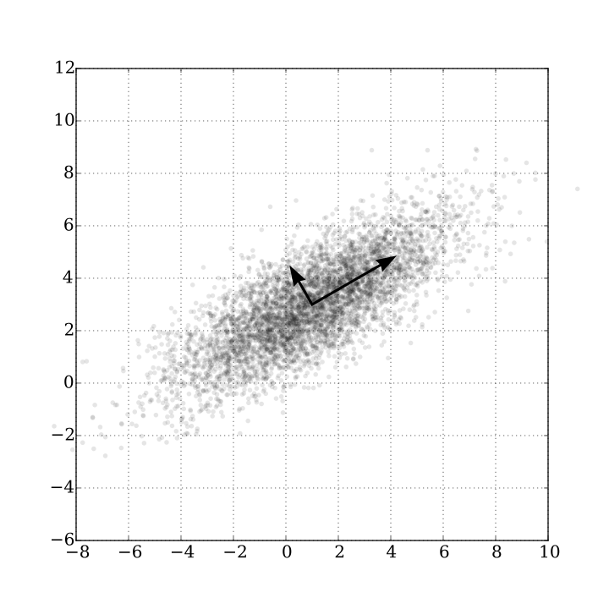
Example: simple PCA illustration
Example: PCA of a multivariate Gaussian distribution
Distribution is centered at (1,3) with a standard deviation of 3 in roughly the (0.866, 0.5) direction and standard deviation of 1 in the orthogonal direction.
The vectors shown are the eigenvectors of the covariance matrix scaled by the square root of the corresponding eigenvalue, and shifted so their tails are at the mean.
Figure is from https://en.wikipedia.org/wiki/Principal_component_analysis

Slide 14
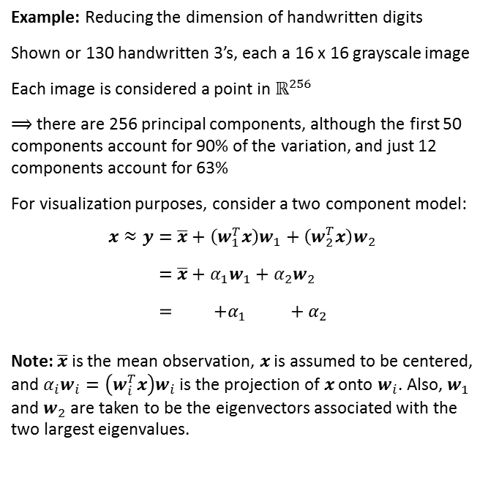
Example: Handwritten Digits
Example: Reducing the dimension of handwritten digits
Shown or 130 handwritten 3’s, each a 16 x 16 grayscale image
Each image is considered a point in $ℝ^{256}$
$⟹$ there are 256 principal components, although the first 50 components account for 90% of the variation, and just 12 components account for 63%
For visualization purposes, consider a two component model:
$$x≈y=\overline{x}+\left(w_{1}^{T}x\right)w_{1}+\left(w_{2}^{T}x\right)w_{2} \\ =\overline{x}+α_{1}w_{1}+α_{2}w_{2} \\ = +α_{1 }+α_{2}$$
Note: $\overline{x}$ is the mean observation, $x$ is assumed to be centered, and $α_{i}w_{i}=\left(w_{i}^{T}x\right)w_{i}$ is the projection of $x$ onto $w_{i}$. Also, $w_{1}$ and $w_{2}$ are taken to be the eigenvectors associated with the two largest eigenvalues.

Slide 15
Example: Handwritten Digits
To gain insights into the roles of the principal components, the coefficients of the first two principal components are plotted for all 130 images
The gridlines are defined as the 5%, 25%, 50%, 75% and 95% quantile points for each component
Circle points denotes images closest to the grid vertices (distance metric incorporates projection and orthogonal subspace distance)
Shown are the 25 “3” images corresponding to the circle points
Observations:
Examining image variations along the horizontal axis (first principal component): first principle component accounts for variation in the length of the lower tail of the 3
Examining image variations along the vertical axis (second principle component): second principle component accounts for variation in character thickness

Slide 16
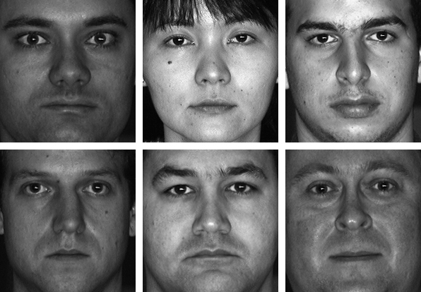
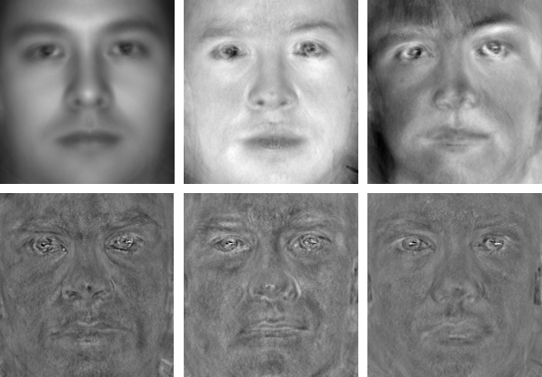
Example: Eigenfaces
Examples of CMU PIE face images.
The leftmost in the first row is the average face, the others are top two eigenfaces; the second row shows eigenfaces with the three smallest eigenvalues.
Example: Eigenfaces is an approach designed to represent variation in a collection of face images, using the information to encode or compare images (face classification)
Consider example images from the CMU PIE face database; database contains >750,000 images of 337 people, imaged under 15 viewpoints and 19 illumination conditions while displaying a range of facial expressions
The eigenfaces may be considered as a set of features which characterize the global variation among face images. Each face image can be approximated using a subset of the eigenfaces, i.e., those associated with the largest eigenvalues
The Eigenface approach is considered to be the first working facial recognition technology
More details can be found at http://www.scholarpedia.org/article/Eigenfaces

Slide 17
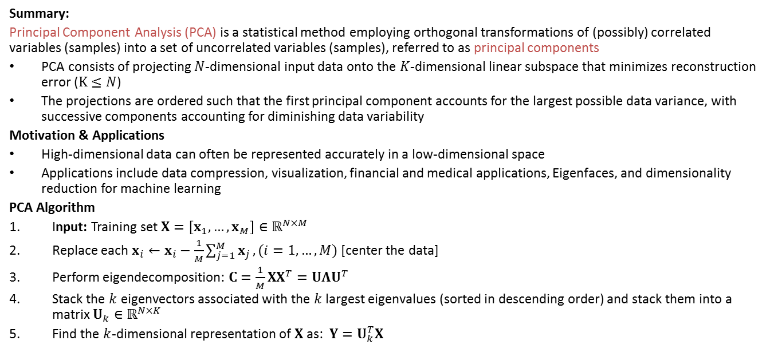
Principal Component Analysis
Summary:
Principal Component Analysis (PCA) is a statistical method employing orthogonal transformations of (possibly) correlated variables (samples) into a set of uncorrelated variables (samples), referred to as principal components
PCA consists of projecting $N$-dimensional input data onto the $K$-dimensional linear subspace that minimizes reconstruction error ($K≤N$)
The projections are ordered such that the first principal component accounts for the largest possible data variance, with successive components accounting for diminishing data variability
Motivation & Applications
High-dimensional data can often be represented accurately in a low-dimensional space
Applications include data compression, visualization, financial and medical applications, Eigenfaces, and dimensionality reduction for machine learning
PCA Algorithm
Input: Training set $X=\left[x_{1},…,x_{M}\right]∈ℝ^{N×M}$
Replace each $x_{i}←x_{i}−\frac{1}{M}\sum_{j=1}^{M}{x_{j}}, (i=1,…,M)$ [center the data]
Perform eigendecomposition: $C=\frac{1}{M}XX^{T}=UΛU^{T}$
Stack the $k$ eigenvectors associated with the $k$ largest eigenvalues (sorted in descending order) and stack them into a matrix $U_{k}∈ℝ^{N×K}$
Find the $k$-dimensional representation of $X$ as: $Y=U_{k}^{T}X$

